Slide 1

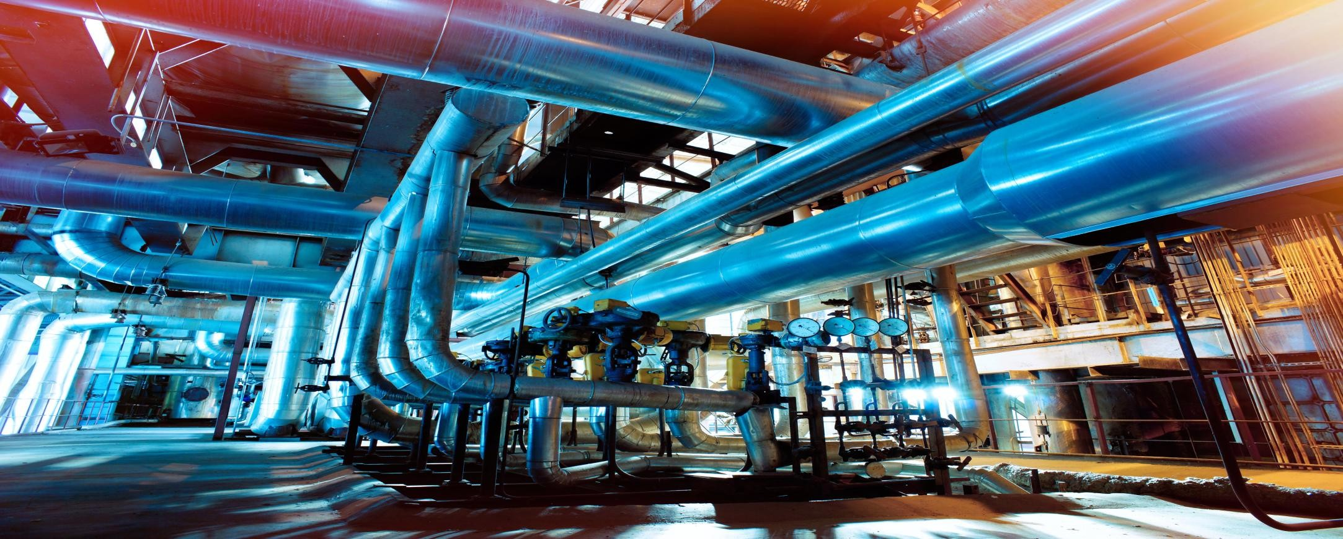
R.I.S.E
CORPORATE OVERVIEW
R
S

Slide 2
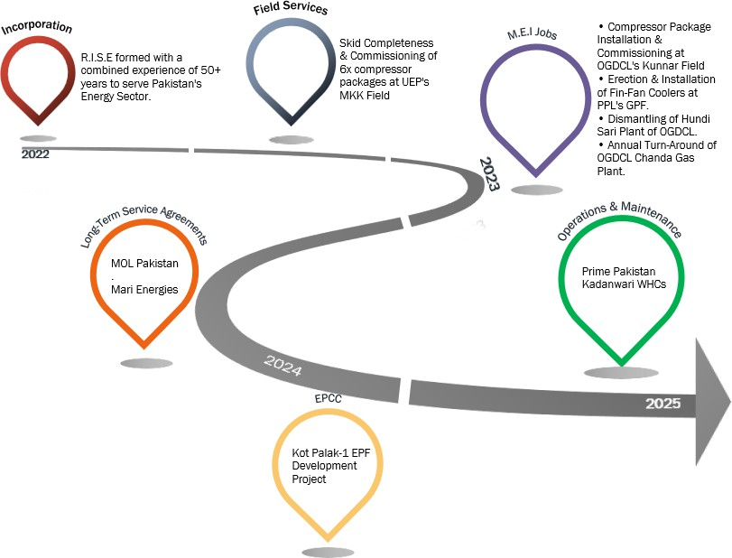
CORPORATE EVOLUTION
R
S

Slide 3

BUSINESS VERTICALS
EPCC: End-to-end project delivery with excellence in Engineering, Procurement, Construction, and Commissioning.
Operations Comprehensive uninterrupted reliability.
& Maintenance: solutions ensuring plant performance and
Field Services: Expert troubleshooting,
support for and
upgrades,
maintaining rotary equipment.
Engineering Consultancy:
Tailored
technical insights and solutions for optimized project execution.
R
S

Slide 4
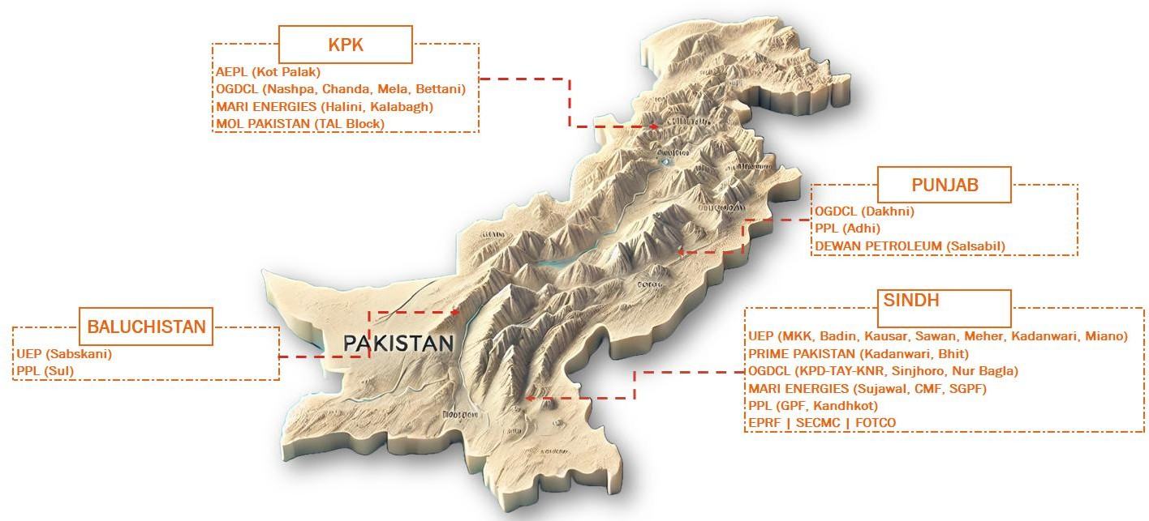
GEOGRAPHICAL PRESENCE
R
S

Slide 5
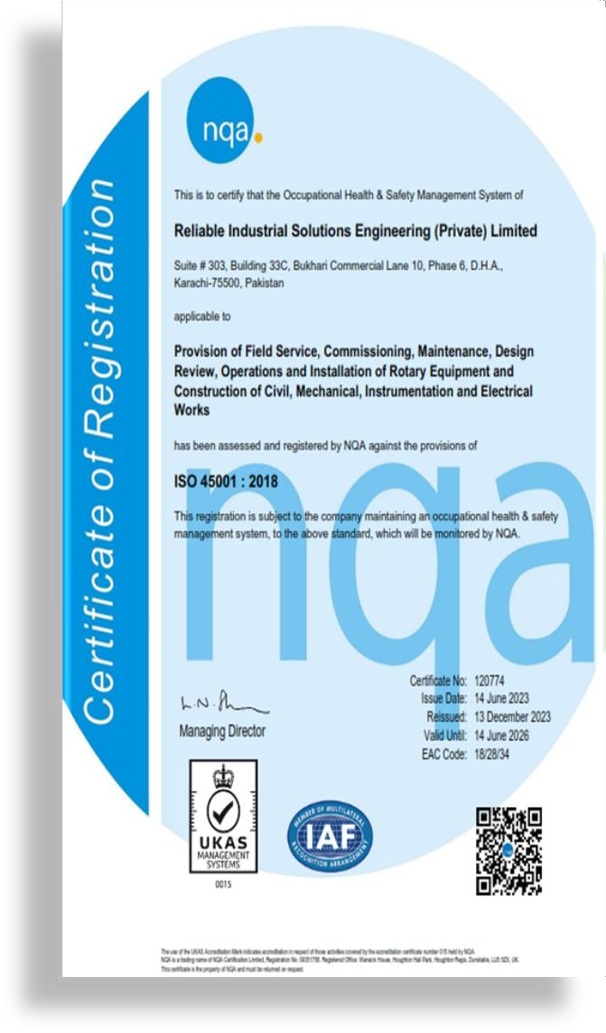
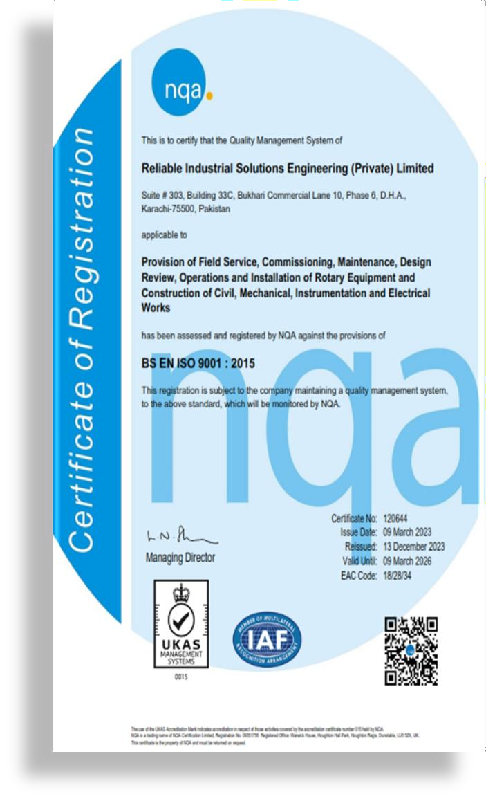

ACCREDITATION
R
S

Slide 6
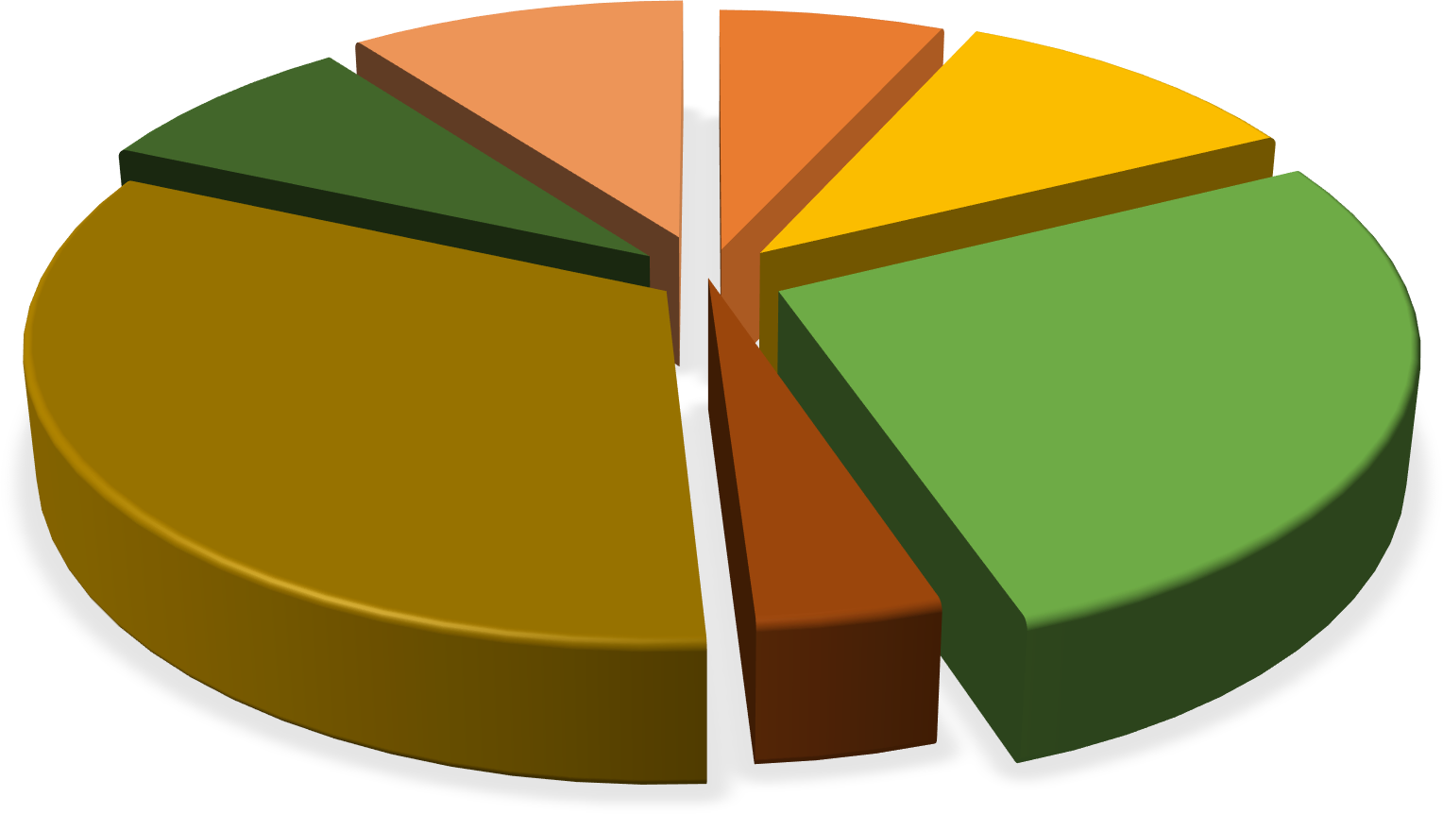
POWERING SUCCESS:
OUR WORKFORCE AT A GLANCE
Back-Office Support
10%
Management 7%
Engineering & Design 11%
Field Services 8%
Construction 27%
Operations & Maintenance 33%
QHSE 4%
R
S

Slide 7












OUR VALUED CLIENTS
R
S

Slide 8

DRIVING EXCELLENCE THROUGH GLOBAL PARTNERS
R
S

Slide 9


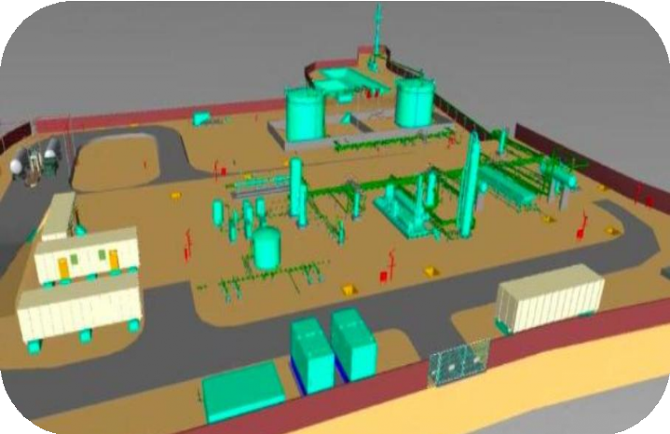
PROJECT: KOT PALAK-1 EPF DEVELOPMENT
Project Nature: EPCC
Customer: Al Haj Enterprises Pvt. Ltd.
Contractor: DZR Energy Pvt. Ltd.
(a Company of Dewan Petroleum)
Sub-contractor: R.I.S.E (EPCC)
Location: ~140 KMs off D.I. Khan, KPK.
Project Value: ~ US$ 10 Mn.
Total Duration: 20 Months
  Project: 8 Months
  O&M: 12 Months.
R
S

Slide 10























PROJECT: KOT PALAK-1 EPF DEVELOPMENT
SCOPE OVERVIEW
Al-Haj Facility (EPF) will mainly handle pressure boosting at 950 Psig for a design flowrate of 50 MMSCFD to sales gas tie-in at pipeline and stabilize / process 2500 BBL / Day Oil / Condensate.
DETAILED ENGINEERING
HISTOGRAM & S- CURVE
46%
100%
92.31%
98.46%
98.58%
98.55%
98.55%
50%
45%
40%
35%
30%
25%
20%
15%
10%
5%
0%
38%
72.31%
32%
40.00%54%
32%
Planned Prog. %age (Month) Earned Prog. %age (Month)
PROGRESS %AGE
Planned Prog. %age (Accumulative)
20%
Earned Prog. %age (Accumulative)
15%
Forcast (Accumulative)
Forcast Monthly
7.691%5%
8%
6%
0%
0%
0%
1.5%
R
S

Slide 11



PROJECT: KOT PALAK-1 EPF DEVELOPMENT
MOBILISATION
Equipment
20x 3rd Party Certified Equipment.
40X10 PORTA CABIN STORE
40X10 PORTA CABIN RESIDENTIAL EXECUTIVE
40X10 PORTA CABIN JUNIOR MESS HALL
40X10 PORTA CABIN SENIOR MESS HALL
40X10 PORTA CABIN RESIDENTIAL EXECUTIVE
4X4 VEHICLE
ROLLER CONCRETE VIBERATOR WATER BOWSER
TYRE EXCAVATOR(S)
CRANE(S)
1
1
2
12x 3rd Party Certified LTV license Operators
1
1
1
1
1
5
1
1
1
1
1
1
2
2
2
2
3
1
3
0
1
2
3
4
5
6
Manpower
Total Management Total Planning Staff Total Civil staff Total QA/QC Staff Total HSE Staff
Total Administration Staff
Total Store staff Total Store Staff Total Local Staff Total Civil Labor Staff
Total Driver & Operators
CHALLENGES
Security / Community Sensitivity.
Remote Location.
Stringent HSE Compliance.
R
S

Slide 12
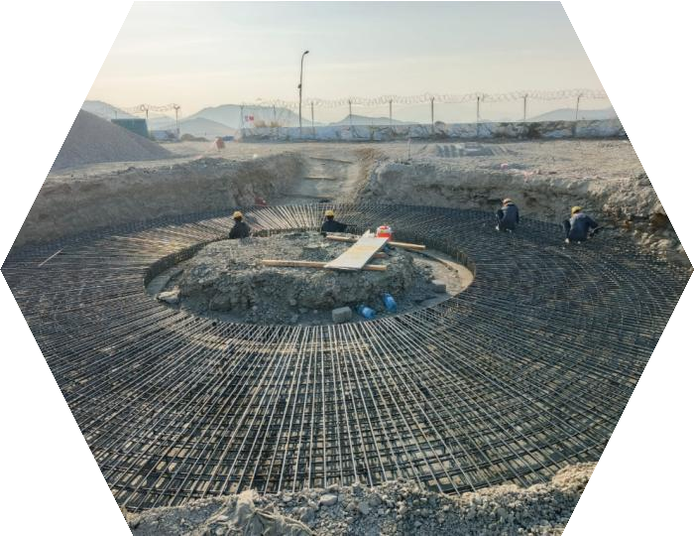
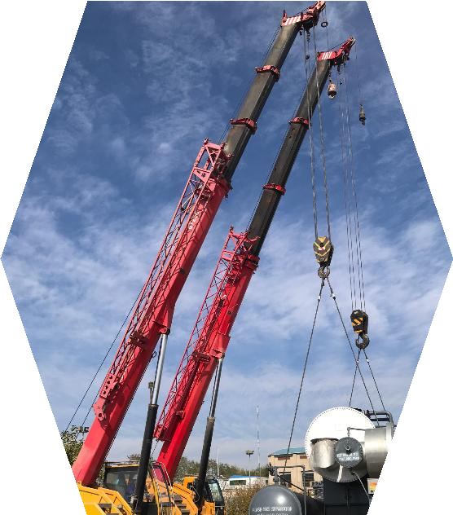
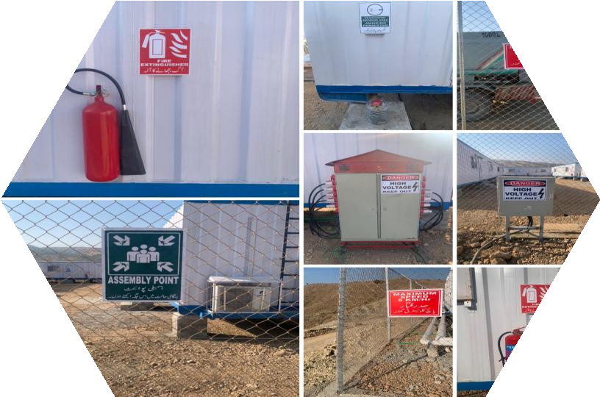
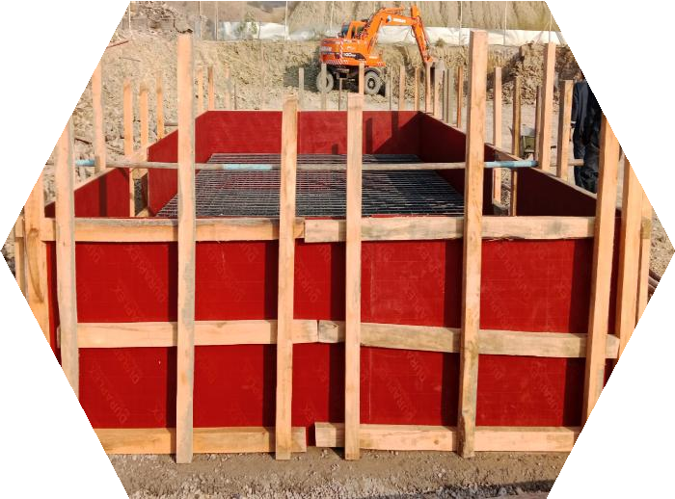
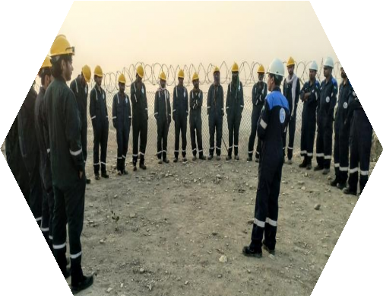
PROJECT: KOT PALAK-1 EPF DEVELOPMENT
CONSTRUCTION
R
S

Slide 13
THANK YOU!
R
S

